Slide 1
Changes to the
Child Protective Act and a New Way to Assume Temporary Foster Custody
Lynne Youmans, Human Services Division
Erin Torres, Family Law Division
Department of the Attorney General

Slide 2
Disclaimer
This presentation is given by Erin Torres and Lynne Youmans in our personal capacities. The views and opinions expressed are our own, and do not necessarily reflect the views and opinions of the State of Hawai‘i, Department of the Attorney General, or the Department of Human Services.
This presentation is not intended to be a substitute for your own diligent research and review of the laws and issues discussed.

Slide 3
ACT 144
In 2024, the Legislature passed Act 144, which amended the Child Protective Act (Hawaii Revised Statutes, Chapter 587A)
Act 144 was signed into law on July 1, 2024, and it went into effect on July 1, 2025

Slide 4
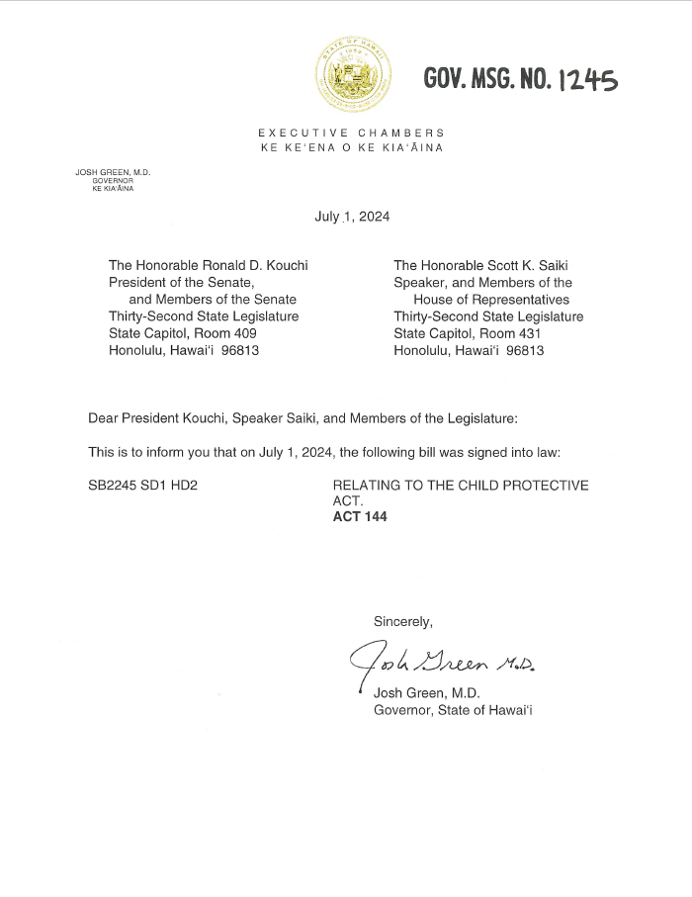
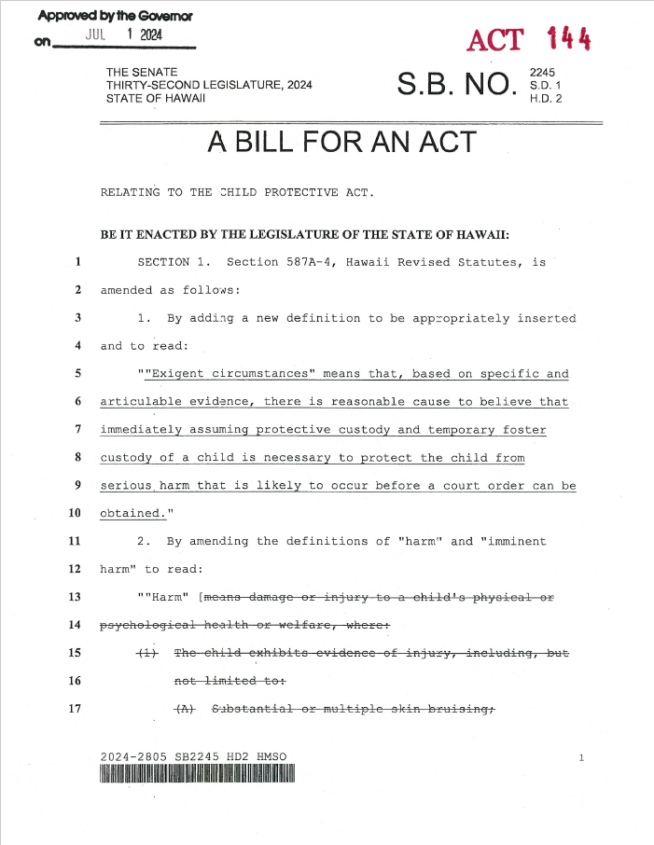

Slide 5
ACT 144
Changed the standard for protective custody and TFC without the consent of the family and without a court order
Created a new process for the DHS to obtain a court order for protective custody and TFC

Slide 6
Housekeeping Amendments
§ 587A-4: “Harm” has the same meaning as “child abuse or neglect” as defined in section 350-1
§ 587A-21(b) allows consideration of relevant hearsay evidence for orders for protective custody
§ 588-2 (Chapter re: CJC) definitions for “child sexual abuse” and “serious physical child abuse” changed to match the new definition of “harm” in § 587A-4

Slide 7
Protective Custody by Police and Temporary Foster Custody to DHS
Consent of the Child’s Family
Exigent Circumstances
Court Order (Imminent Harm)

Slide 8
New Standard for Police and the DHS:
EXIGENT CIRCUMSTANCES
based on specific and articulable evidence, there is reasonable cause to believe that immediately assuming protective custody and temporary foster custody of a child is necessary to protect the child from serious harm that is likely to occur before a court order can be obtained

Slide 9
Standard for the Court to Order TFC:
IMMINENT HARM
OLD: without intervention within the next ninety days, there is reasonable cause to believe that harm to the child will occur or reoccur
NEW: there is reasonable cause to believe that harm to the child will occur or reoccur and no reasonable efforts other than removal of the child from the family home will adequately prevent the harm

Slide 10
3 Pathways to Court Orders for Custody
Exigent Circumstances
Protective Custody and TFC Taken
TFC Petition
Court Hearing
1
Imminent Harm
TFC Petition + Ex Parte Motion for Protective Custody
Court Orders Protective Custody and TFC
Protective Custody and TFC Taken
Court Hearing
2
Harm or Threatened Harm
Foster Custody Petition
Court Hearing
3

Slide 11
New Process:
Orders for Protective Custody
٭ See HRS § 587A-11(9)
DHS files a petition AND an ex parte motion for protective custody with a declaration
The court issues an order for protective custody if it finds reasonable cause to believe that the child is subject to IMMINENT HARM

Slide 12
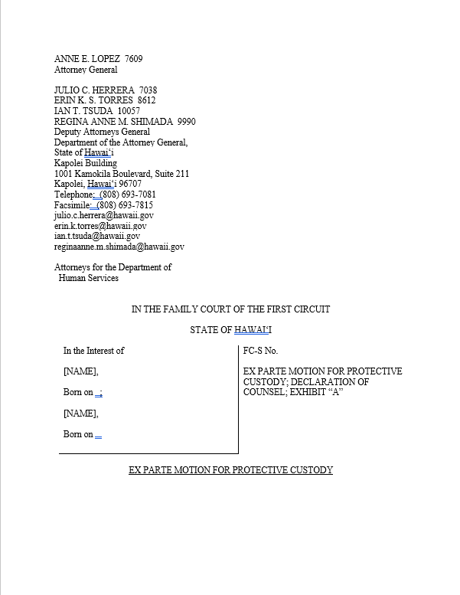
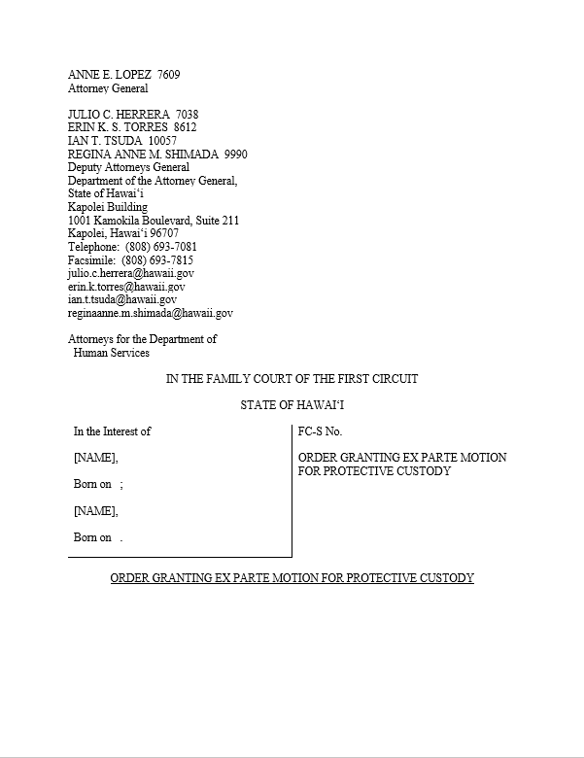

Slide 13
What’s in an
Order for Protective Custody?
A police officer shall immediately take the child into protective custody and transfer custody to the DHS, which will then assume TFC
A police officer shall make every reasonable effort to personally serve the child’s parents and any person who has physical custody of the child with copies of the ex parte motion and order
All parties shall appear at a TFC hearing

Slide 14
New Process:
Orders for Protective Custody
DHS requests court info
DHS prepares Report
DHS investigation leads to confirmation of IMMINENT HARM
Documents are signed and dropped off at court
DHS and FLD prepare documents for filing ٭
DHS communicates with police
Note: the court is only accessible during regular business hours

Slide 15
PETITION PACKETS | FCT1 | FCT2 | GAL | PFAC | MO ATTY | FA ATTY | DAG1 | DAG2 | MO Ext | FA Ext | Police | P.Cust.1 | P.Cust.2 | MO | FA | SW | UNIT | FPPEU | TOTAL
Petition | X | X | X | X | X | X | X | X | X | X |  |  |  | X | X | X | X | X | 15
Mother's Summons | X | X | X | X | X |  | X | X | X |  |  |  |  | X |  | X | X | X | 12
Father's Summons | X | X | X | X |  | X | X | X |  | X |  |  |  |  | X | X | X | X | 12
Ex Parte Motion | X | X | X | X | X | X | X | X | X | X | X | X | X | X | X | X | X | X | 18
Ex Parte Order | X | X | X | X | X | X | X | X | X | X | X | X | X | X | X | X | X | X | 18
Mother's Request for Service |  |  |  |  |  |  |  |  | X |  |  |  |  | X |  | X | X |  | 4
Father's Request for Service |  |  |  |  |  |  |  |  |  | X |  |  |  |  | X | X | X |  | 4
Mother's Proof of Service |  |  |  |  |  |  |  |  | X |  |  |  |  | X |  | X | X |  | 4
Father's Proof of Service |  |  |  |  |  |  |  |  |  | X |  |  |  |  | X | X | X |  | 4
P.Cust.1 Proof of Service |  |  |  |  |  |  |  |  |  |  |  | X |  |  |  | X | X |  | 3
P.Cust.2 Proof of Service |  |  |  |  |  |  |  |  |  |  |  |  | X |  |  | X | X |  | 3
Transmittal | X | X | X | X | X | X | X | X | X | X |  |  |  | X | X | X | X | X | 15
Face Sheet | X | X | X | X | X | X | X | X |  |  |  |  |  |  |  | X | X | X | 11
Report for Orders for Prot. Custody | X | X | X | X | X | X | X | X | X | X |  |  |  | X | X | X | X | X | 15
Attachments | X | X | X | X | X | X | X | X | X | X |  |  |  | X | X | X | X | X | 15

Slide 16
New Process:
Orders for Protective Custody
DHS picks up documents and assembles packets ٭
Court staff conforms and files documents
Judge reviews ex parte motion and signs order
DHS and police effectuate removal
DHS coordinates with police re: removal
DHS drops off court’s packets

Slide 17
New Process:
Orders for Protective Custody
DHS prepares SFHR and FSP
DHS places Child and continues assessment
Police serve physical custodians and parents
DHS files/ distributes SFHR, FSP, and Proofs
DHS gets documentation back from police
Court hearing

